Slide 1

Mission - to spark a movement -- a loud voice, a breeding ground for new ideas, a massive force, a deep talent pool -- that powers the open web to new heights.

Slide 2

Our mission is to ensure the Internet is a global public resource, open and accessible to all. An Internet that truly puts people first, where individuals can shape their own experience and are empowered, safe and independent.
A Mozilla Club brings people together locally to build the open web on University and College campuses worldwide.
The Internet is more than computers and code. The Internet is about people. And this is what Mozilla Clubs are all about: interacting with others to share, learn, teach, protect and build upon platforms, to make things that matter.

Slide 3

BUILD
We need skilled communities of makers and innovators developing and supporting robust technologies that keep the web open and accessible to all.
LEARN
In order to use and build the web as a global public resource people must have the skills to read, write, and participate online.
ADVOCATE
In order for the web to stay open and accessible to all, people need to feel safe online and know how to fight for and defend against the biggest challenges and opportunities that face the internet today.

Slide 4





BUILD
Contribute to GNOME Apps
Build a Virtual World using A-FRAME
Build Browser Extensions
Build HTML5 Games using Phaser
Hack Existing Open Source Projects and more!

Slide 5




LEARN
Open Source Communities
Licensing
Git and Github
Learn New Languages and Frameworks
HTML5
Python
Rust
More!

Slide 6

ADVOCATE
Digital Freedom
Net Neutrality
Copyright Reform
Diversity and Inclusion
Reform Mass Surveillance
Encryption

Slide 7


Slide 8
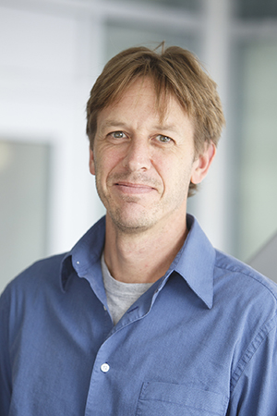




Dr. Matt Germonprez
Associate Professor at University of Nebraska at Omaha
Contributing and Researching open source development for 10 + years
Founding member and on the Board of Directors of Community Health and Analytics in Open Source Software (CHAOSS), a Linux Foundation project.
President of SigOpen, an AIS community dedicated to the advancement of scientific inquiry of open communities.

Slide 9
Insert Matt’s Slides

Slide 11

Join the club by visiting MavSync!
https://orgsync.com/170244/chapter
UNO Mozilla Campus Club is open to people of all skill levels!
We are looking for passionate individuals to take leadership positions to help build our community!

